Slide 1

Introduction to Artificial Neural Networks
Hao Ji, Data Scientist
USC Center for Advanced Research Computing

Slide 2
Introduction
Neural Networks
Applications
PyTorch
Content
Introduction
Section 1: Introduction to Deep Learning
Section 2: Neural Networks
Neural Networks
Applications
Section 3: Applications
PyTorch
Section 4: Building Neural Networks with PyTorch

Slide 3
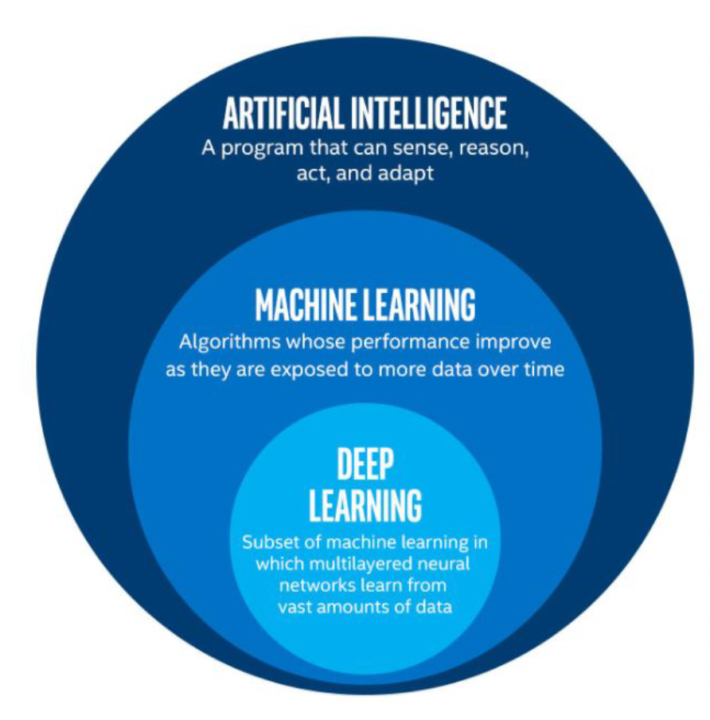
Introduction
Neural Networks
Applications
PyTorch
Introduction to Deep Learning
Deep Learning: subfield of traditional machine learning
Inspired by the structure and function of the brain: Artificial Neural Networks
Computer vision: Tesla recognizing items on a street
Text Generation: An algorithm trained to create a new Shakespeare piece
Speech recognition
Computer Games: AlphaGo

Slide 4
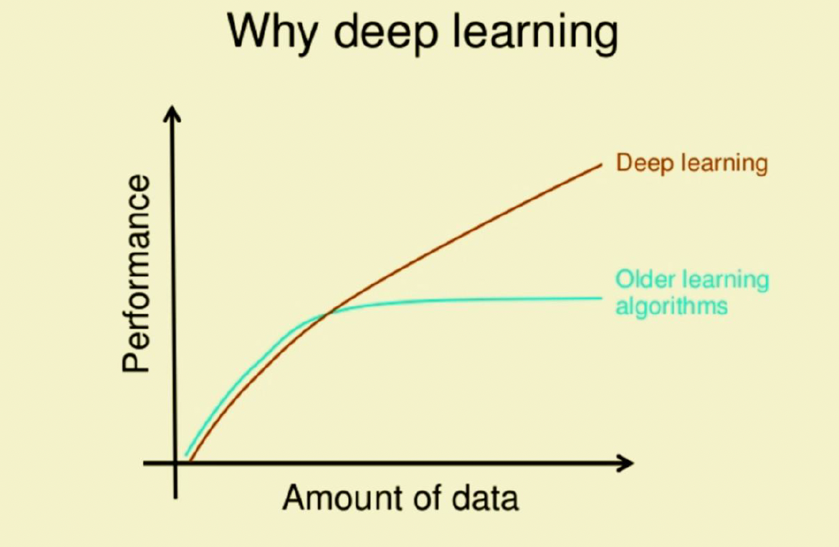
Introduction
Neural Networks
Applications
PyTorch
Introduction to Deep Learning
What drives the recent development of Deep Learning?
Larger amounts of data available
Data Storage
Strong computation units such as GPU’s

Slide 5
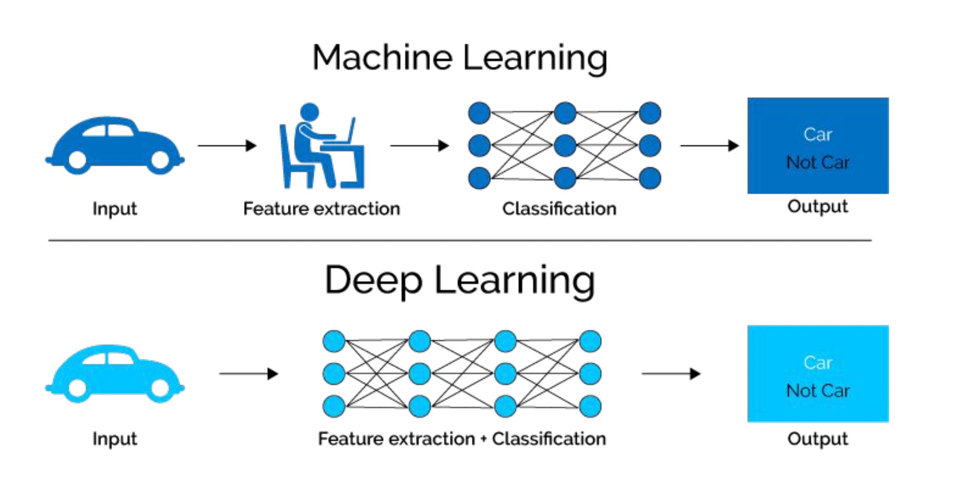
Introduction
Neural Networks
Applications
PyTorch
Introduction to Deep Learning

Slide 6
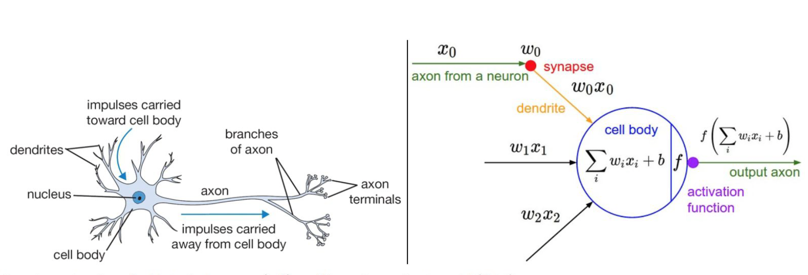
Introduction
Neural Networks
Applications
PyTorch
Neural Networks
biological neuron
artificial neural networks

Slide 7
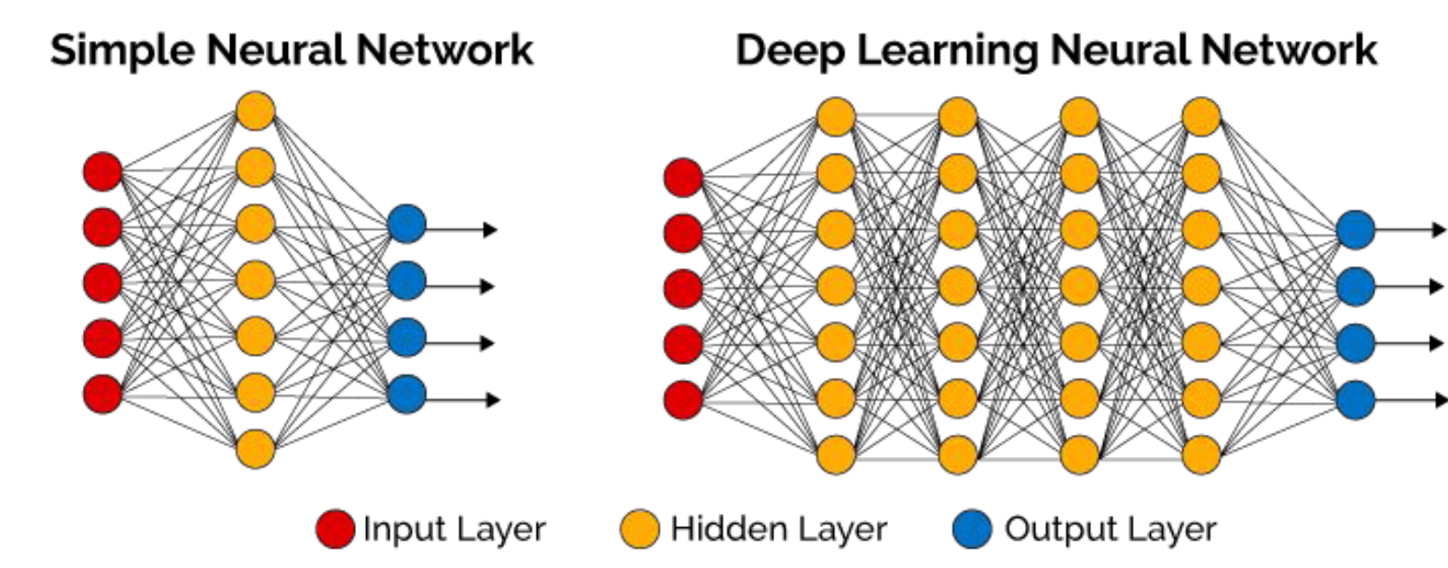
Introduction
Neural Networks
Applications
PyTorch
Neural Networks
Deep neural networks (DNN) usually has more hidden layers
Still has same 3 types of layers
A neural network (NN) has 3 types of layers:
Input layer Hidden layer Output layer

Slide 8
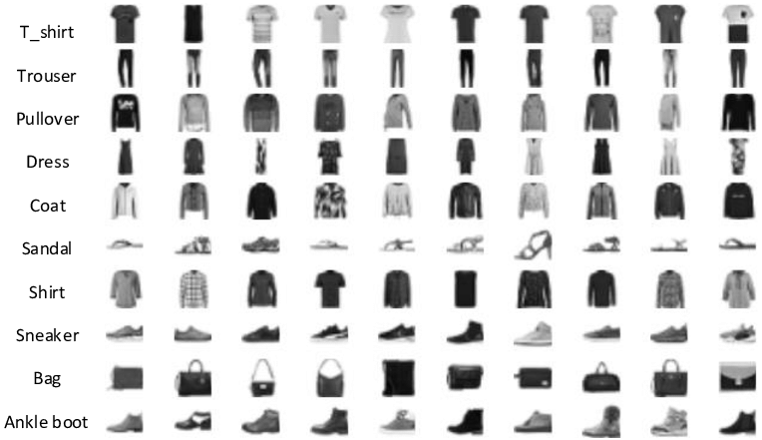
Introduction
Neural Networks
Applications
PyTorch
Building Neural Networks
Task: Predict if an input image belongs to one of the following classes: T-shirt/top, Trouser, Pullover, Dress, Coat, Sandal, Shirt, Sneaker, Bag, or Angle boot.
FasionMNIST Dataset
Fashion-MNIST is a dataset comprising of 28×28 grayscale images of 70,000 fashion products from 10 categories, with 7,000 images per category. The training set has 60,000 images and the test set has 10,000 images.

Slide 9
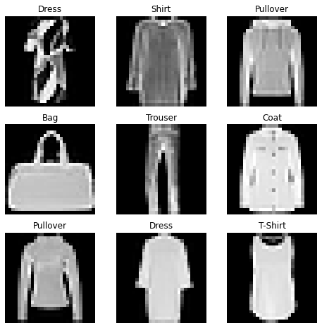
Introduction
Neural Networks
Applications
PyTorch
Building Neural Networks
Make Predictions based on Logits
Input X: (28 * 28)

Slide 10
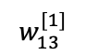
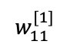
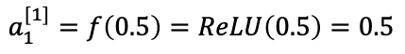
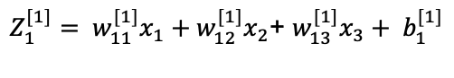
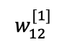
Introduction
Neural Networks
Applications
PyTorch
Building Neural Networks
0.5
$$w_{11}^{[1]}$$
0.4
$$w_{12}^{[1]}$$
$Z_{1}^{[1]}= w_{11}^{[1]}x_{1}+w_{12}^{[1]}x_{2}$+ $w_{13}^{[1]}x_{3}+ b_{1}^{[1]}$
0.2
$$w_{13}^{[1]}$$
$=0.5 ∗0.4+0.1 ∗0.2+0.8 ∗0.1+0.2=0.5$
$$a_{1}^{[1]}=f\left(0.5\right)=ReLU\left(0.5\right)=0.5$$
0.1
Weights are initialized randomly
28 * 28 = 784
A_1

Slide 11
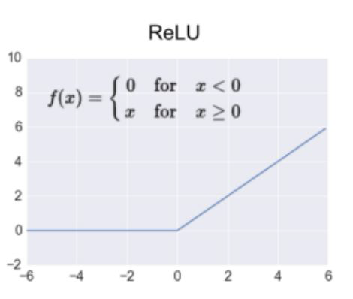
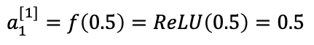
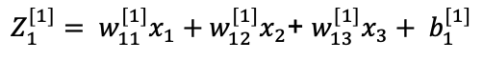
Introduction
Neural Networks
Applications
PyTorch
Building Neural Networks
$Z_{1}^{[1]}= w_{11}^{[1]}x_{1}+w_{12}^{[1]}x_{2}$+ $w_{13}^{[1]}x_{3}+ b_{1}^{[1]}$
$=0.5 ∗0.4+0.1 ∗0.2+0.8 ∗0.1+0.2=0.5$
$$a_{1}^{[1]}=f\left(0.5\right)=ReLU\left(0.5\right)=0.5$$

Slide 12
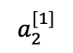
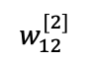
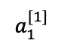
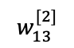
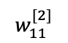
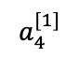
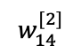
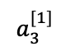
Introduction
Neural Networks
Applications
PyTorch
Building Neural Networks
$$a_{1}^{[1]}$$
0.5
$$w_{11}^{[2]}$$
0.4
$$a_{2}^{[1]}$$
0.89
0.2
$$w_{12}^{[2]}$$
0.2
2
$$a_{3}^{[1]}$$
$$w_{13}^{[2]}$$
0.3
3
$Z_{1}^{[2]}= w_{11}^{[2]}a_{1}^{[1]}+w_{12}^{[2]}a_{2}^{[1]}$+ $w_{13}^{[2]}a_{3}^{[1]}+w_{14}^{[2]}a_{4}^{[1]}+b_{1}^{[2]}$
0.1
$$w_{14}^{[2]}$$
$$a_{4}^{[1]}$$
$=0.3 ∗0.5+0.1 ∗0.2+0.2 ∗0.3+0.4 ∗0.9+ 0.3$
$=0.89$
0.9
$$a_{1}^{[2]}=f\left(Z_{1}^{[2]}\right)=f\left(0.89\right)=ReLU\left(0.89\right)=0.89$$
A_1

Slide 13
Introduction
Neural Networks
Applications
PyTorch
Neural Networks
Three steps to training a neural network
1 Forward propagation: push example through the network to get a predicted output
2 Compute the cost: calculate the difference between predicted output and actual data
3 Backward propagation: push back the derivative of the error and apply to each weight, such that next time it will result in a lower error

Slide 14
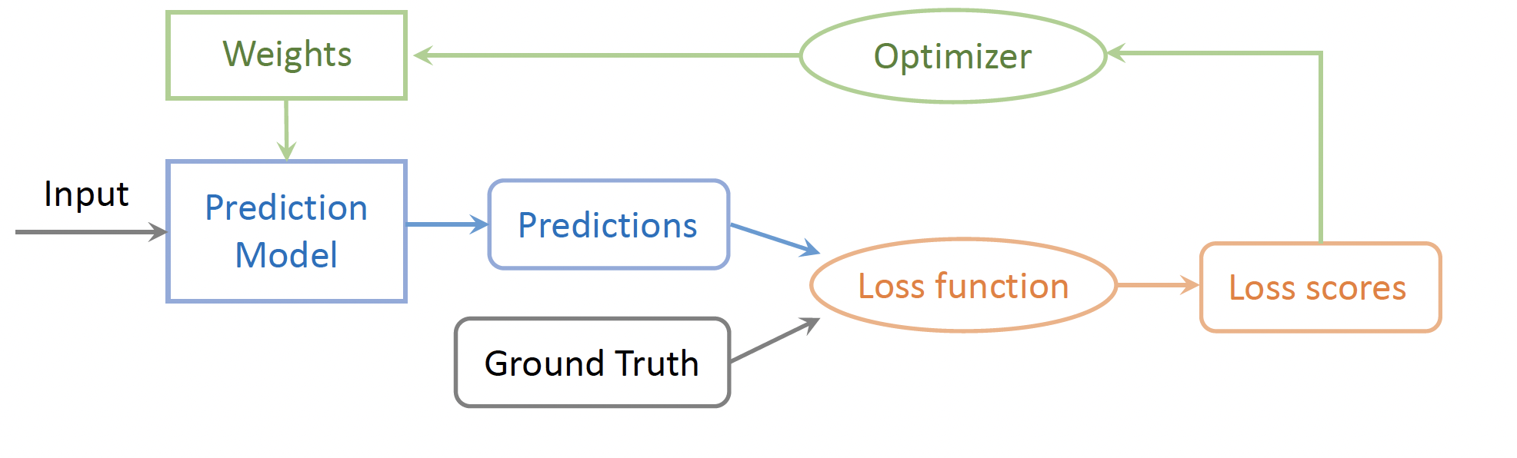
Introduction
Neural Networks
Applications
PyTorch
Training Pipeline
The training pipeline consists of choosing the prediction model, the loss function and the optimizer.
Once these choices are made, we can feed the input data and labels to start the training process.

Slide 15
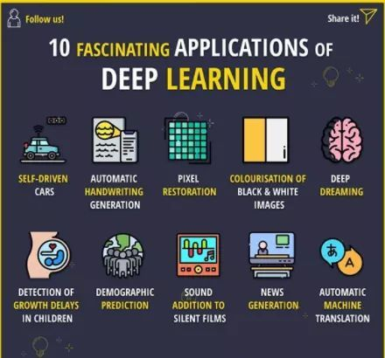
Introduction
Neural Networks
Applications
PyTorch
Deep Learning Applications
Deep Learning Applications
Notes:
DeepDream is a computer vision program created by Google engineer Alexander Mordvintsev that uses a convolutional neural network to find and enhance patterns in images via algorithmic pareidolia, thus creating a dream-like appearance reminiscent of a psychedelic experience in the deliberately overprocessed images

Slide 16

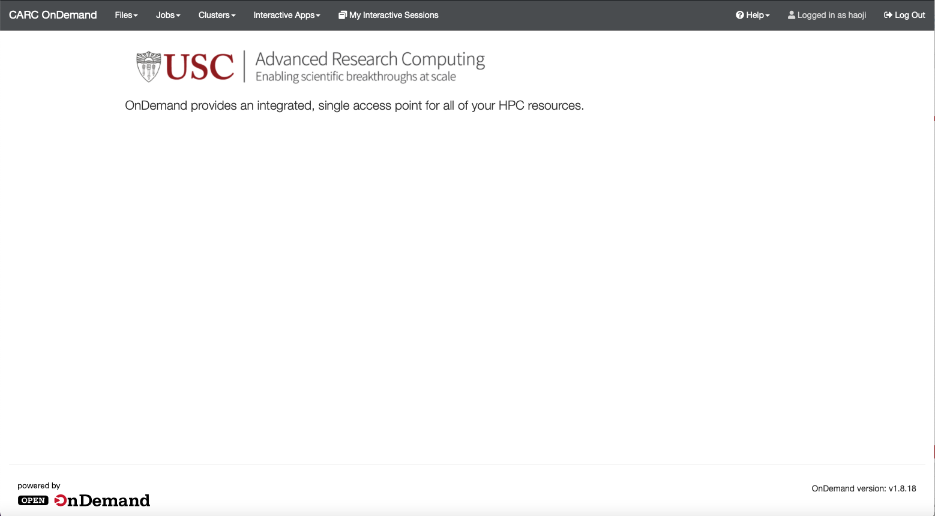
Introduction
Neural Networks
Applications
PyTorch
CARC OnDemand
Web Address: https://ondemand.carc.usc.edu

Slide 17
Introduction
Neural Networks
Applications
PyTorch
Using Conda on CARC
Within ‘Discovery Cluster Shell Access’, Request an interactive session first using salloc
salloc --partition=gpu --nodes=1 --ntasks=1 --cpus-per-task=8 --time=1:00:00 --mem=32GB --gres=gpu:1

Slide 18
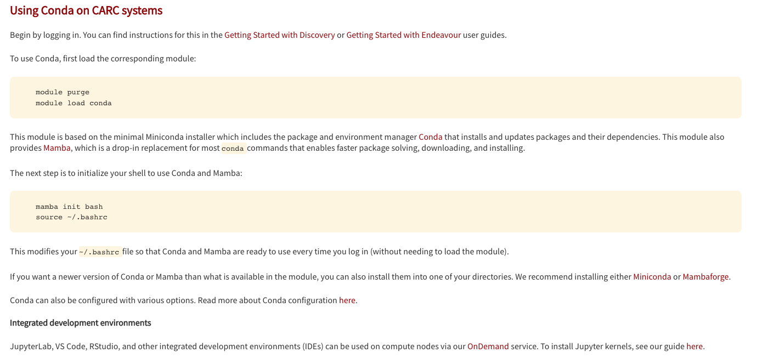
Introduction
Neural Networks
Applications
PyTorch
Using Conda on CARC
Anaconda: package and environment manager primarily used for open-source data science packages for the Python and R programming languages.
https://www.carc.usc.edu/user-information/user-guides/software-and-programming/conda

Slide 19
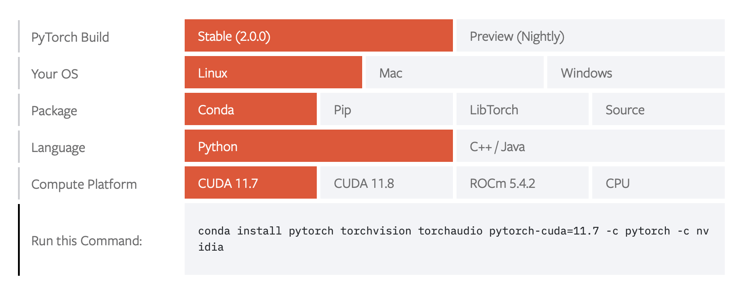
Introduction
Neural Networks
Applications
PyTorch
Using Anaconda on CARC
https://pytorch.org
Install PyTorch:
1 mamba create –n torch_env
2 mamba activate torch_env
3 mamba install pytorch torchvision torchaudio pytorch-cuda=11.8 -c pytorch -c nvidia
Test installation: type python and import torch

Slide 20
Introduction
Neural Networks
Applications
PyTorch
Using Anaconda & Juypyter Kernel
Conda Environment
Jupyter Kernel
OpenOnDemand
Jupyter Notebook

Slide 21
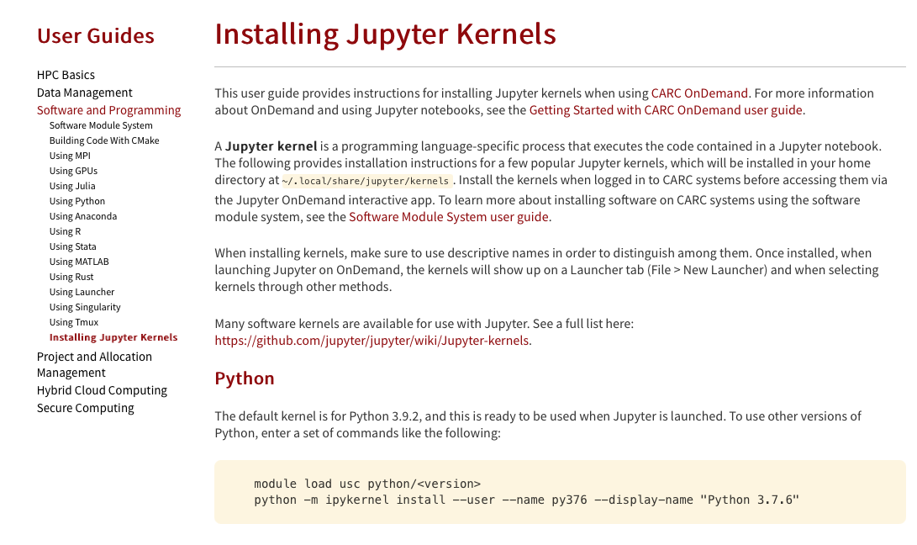
Introduction
Neural Networks
Applications
PyTorch
Creating Jupyter Kernel
A Jupyter kernel is a programming language-specific process that executes the code contained in a Jupyter notebook.
https://www.carc.usc.edu/user-information/user-guides/software-and-programming/jupyter-kernels

Slide 22
Introduction
Neural Networks
Applications
PyTorch
Jupyter Kernel
Install Jupyter kernel:
module purge
conda activate torch_env
mamba install -c conda-forge ipykernel
python -m ipykernel install --user --name torch_env --display-name "torch_env"
Notes:
transform and target_transform to modify the samples and lables respectively

Slide 23
Introduction
Neural Networks
Applications
PyTorch
Jupyter Kernel
git clone https://github.com/jihao2021/workshop_building_deepNN_with_python.git
Notes:
transform and target_transform to modify the samples and lables respectively

Slide 24
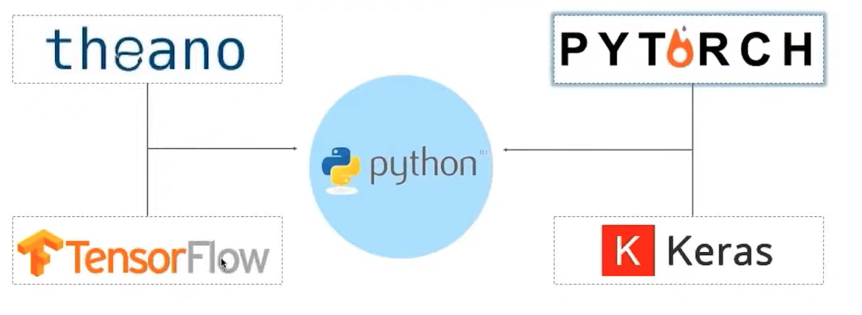
Introduction
Neural Networks
Applications
PyTorch
Neural Networks Packages
Facebook
Google

Slide 25
Introduction
Neural Networks
Applications
PyTorch
Pytorch Tensors
Tensors are a specialized data structure similar to arrays and matrices
PyTorch uses tensors to encode the inputs and outputs of a model, as well as model’s parameters
Can run on GPUs or other hardware accelerators
Optimized for automatic differentiation

Slide 26
Introduction
Neural Networks
Applications
PyTorch
Pytorch Tutorial
Machine Learning Workflows
Working with data
Creating models
Optimizing model parameters
Saving the trained models

Slide 27
Introduction
Neural Networks
Applications
PyTorch
Pytorch Tutorial
Predict if an input image belongs to one of the following classes: T-shirt/top, Trouser, Pullover, Dress, Coat, Sandal, Shirt, Sneaker, Bag, or Angle boot.
FasionMNIST Dataset

Slide 28
Introduction
Neural Networks
Applications
PyTorch
Pytorch Tutorial: Working with Data
Dataset: stores the samples and their corresponding labels TorchText, TorchVision, and TorchAudio
torchvision.datasets: CIFAR, COCO, FashionMNIST
PyTorch
DataLoader: wraps an iterable around the Dataset
Notes:
transform and target_transform to modify the samples and lables respectively

Slide 29
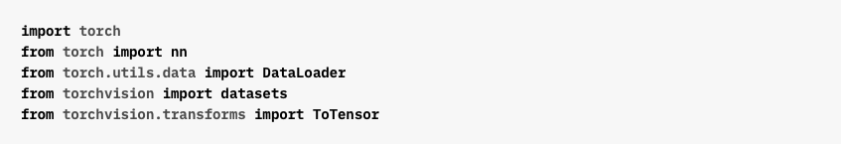
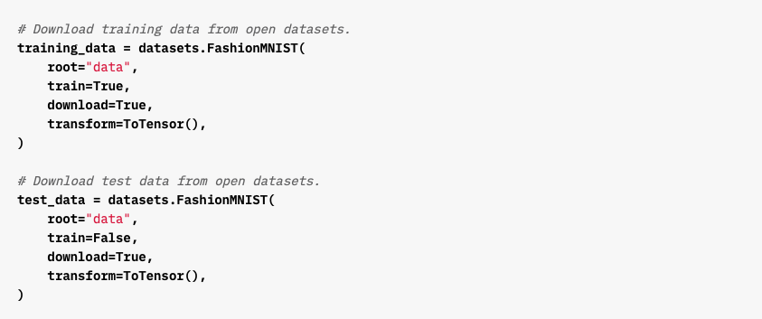
Introduction
Neural Networks
Applications
PyTorch
Working with Data
Importing Modules
Define Training and Test Dataset

Slide 30
Introduction
Neural Networks
Applications
PyTorch
Working with Data
Importing Modules
Define Training and Test Dataset

Slide 31
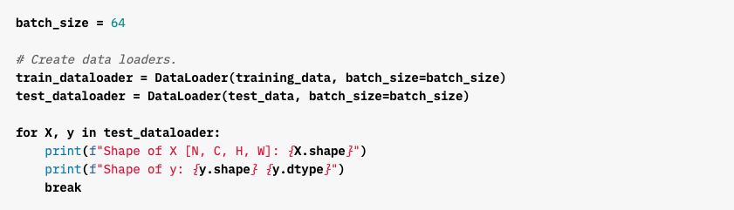
Introduction
Neural Networks
Applications
PyTorch
Working with Data
Pass the Dataset as an argument to DataLoader
Wraps an iterable over dataset and supports automatic batching, sampling, shuffling and multiprocess data loading
Define DataLoader

Slide 32
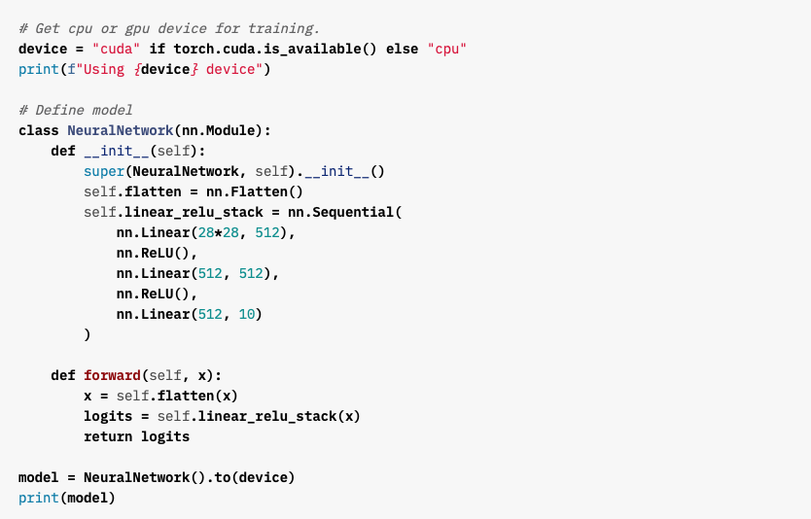
Introduction
Neural Networks
Applications
PyTorch
Creating Models
Check if GPU is Available
Create Neural Networks Model

Slide 33
Introduction
Neural Networks
Applications
PyTorch
Optimizing the Model Parameters

Slide 34
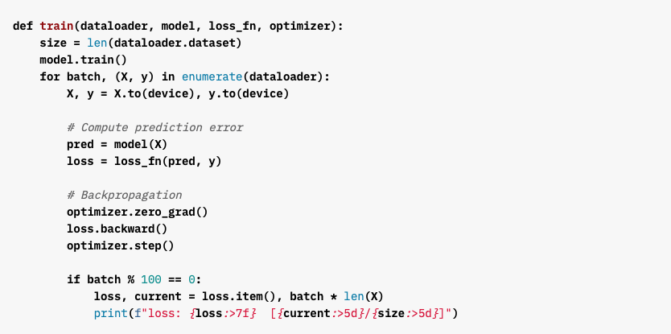
Introduction
Neural Networks
Applications
PyTorch
Define Training Loop

Slide 35
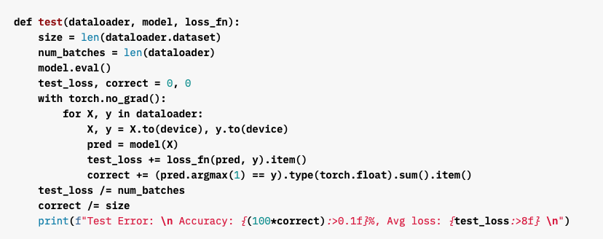
Introduction
Neural Networks
Applications
PyTorch
Define Test Dataset

Slide 36
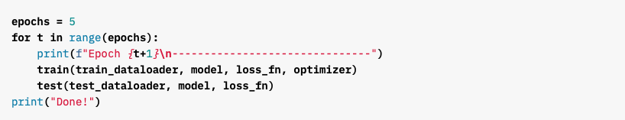
Introduction
Neural Networks
Applications
PyTorch
Training Loop

Slide 37
Introduction
Neural Networks
Applications
PyTorch
Saving Models

Slide 38
Introduction
Neural Networks
Applications
PyTorch
Loading Models

Slide 39
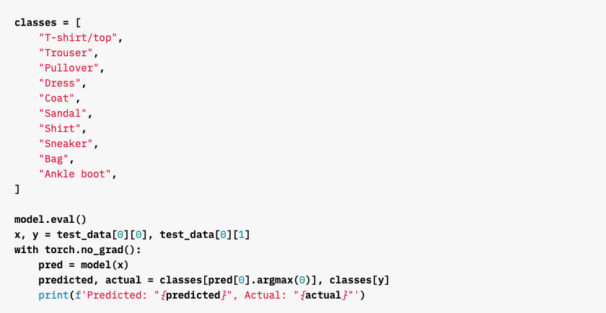
Introduction
Neural Networks
Applications
PyTorch
Make Predictions

